Slide 1
The kingdoms of life
Year 7 Science

Slide 2

Review
FPCOFGS – list the levels of classification.
Which classification levels are in the scientific name of a species?
How many body parts do crustaceans have?
How many legs do arachnids have?
Name two types of myrapods.
What type of arthropods are bees, flies and crickets? How can you tell?

Slide 3
Learning Intentions
Grouping a variety of organisms on the basis of similarities and differences in particular features

Slide 4
Success criteria
List the 6 kingdoms.
Describe features of each kingdom.
Give an example of each kingdom.
Explain why humans are in the animal kingdom.

Slide 5
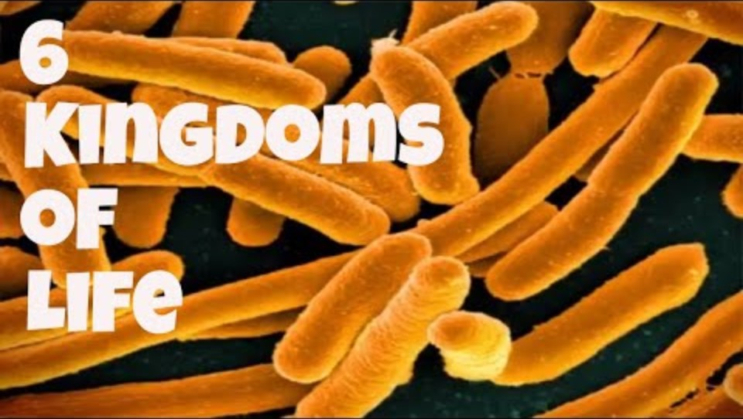

Slide 6
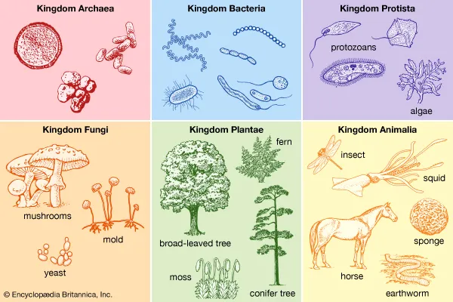

Slide 7
Activity: Kingdoms of life
ng science

Slide 8
Success criteria
List the 6 kingdoms.
Describe features of each kingdom.
Give an example of each kingdom.
Explain why humans are in the animal kingdom.

